Slide 1
Understanding Organic/Natural Farming
Ramanjaneyulu
Centre for Sustainable Agriculture

Slide 2
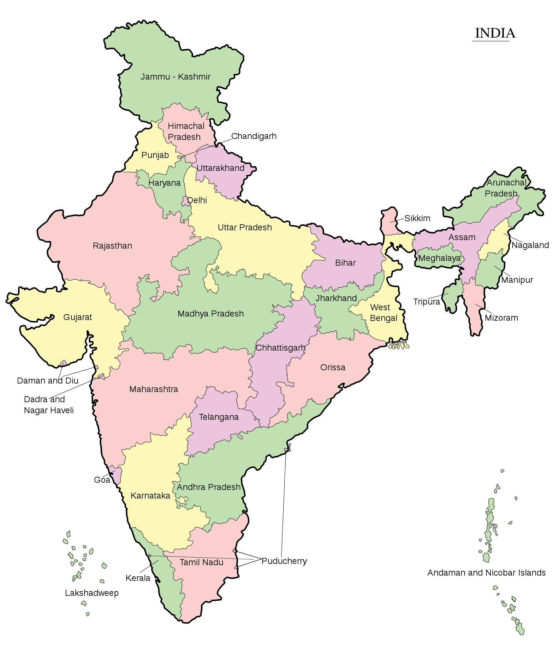
Centre for Sustainable agriculture http://www.csa-india.org
Not for Profit Trust working with 25,000 Organic farmers 75,000 farmers in conversion spread over 60 FPOs
Support Organic transition and FPO formation with about one lakh farmers spread over 150 FPOs
Learning ground: Andhra Pradesh, Telangana and Maharashtra
Support Services in Assam, Chhattisgarh, Himachal Pradesh, Karnataka, Madhya Pradesh, Manipur, Nagaland, Sikkim, and Tamil Nadu
Linking to markets
Policy research
FPOs promotion
FPOs Support
Organic Transition
PGS Certification
Policy Research
Innovations in farming
Sustainable livelihoods
Community Enterprises
Public Policy

Slide 3
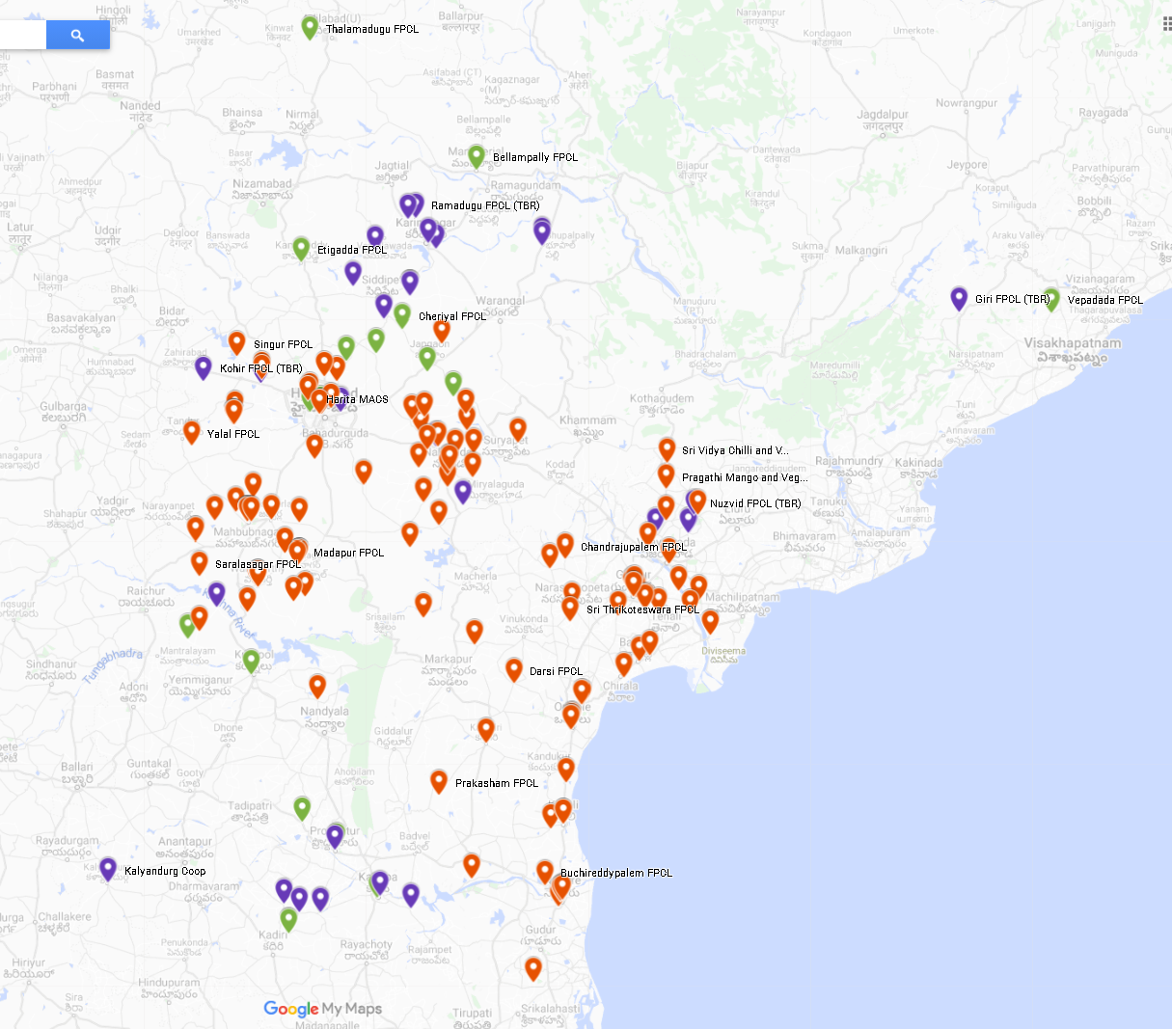
Development Clusters
FPOs promoted and supported by CSA
(AP, Telangana, Maharashtra)
Coastal Andhra Pradesh, Vijayawada, AP
(Vijayanagaram, Vishakapatnam, Krishna dists)
7 FPOs (1 POPI, 1 CSA promoted, 5 CBBO)
2 Food hub
2 stores
Focus: Organic exports, tribal areas, Capital area
Maharashtra
Rayalaseema Cluster, Pulivendula, Kadapa, AP
(Kadapa, Anantapur, Kurnool)
14 FPOs (5 CBBO 8 POPI and 1 CSA)
All organic and part of APCNF program
Potential for Food hub and stores
Focus: all crops, rainfed clusters
38
North Telangana Cluster, Warangal, Telangana
(Adilabad, Mancherial, Karimnagar, Siricilla, Bhupalpalli , sangareddy, medak,)
18 FPOs (11 CBBO 8 POPI)
1 Food hub, 1 distribution hub and 3 organic stores
Focus: Organic, Tribal areas, Chillies, Turmeric
21
Exclusive Organic FPOs
Paddy, Mango, Banana, Chillies, Turmeric, Coffee, Vegetables
30
Southern Telangana Cluster, Mahaboobnagar, Telangana
(Gadwal, Mahabubnagar, Nagarkurnool, Vikarabad, Nalgonda, Jangoan, Yadadri Bhongir, siddipet)
20 FPOs (18 CBBO 2 POPI)
Potential for Food hubs and stores
Potential for stores and processing facilities
Focus: Organic food, cotton, processed food, seeds
29
Mixed FPOs
Cereals, pulses, Oilseeds, spices, Fruits and Vegetables
150
Resource Support Agency
CBBOs
Vidharba Cluster, Wardha, Maharashtra
(Yavatmal, Wardha, Aurangabad)
2 FPOs (2 Organic)
Potential for Food hub
Potential for stores
POPI/Promoter
Foodhubs

Slide 4
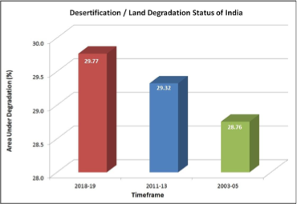
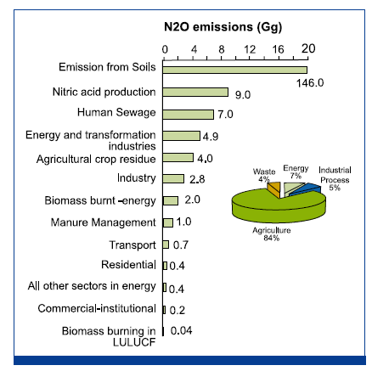
Agro-Ecological Indicators
GHG emissions from Agriculture
Where we stand?
19.6 %
78 %
84 %
Source: Divya Veluguri et.al, EPW, june 29, 2019 vol lIV nos 26 & 27 | India
Pesticide consumption (kg/ha) | 0.35
Use of Farm Yard Manure (kg/ha) | 1037
% Soils with low and medium Organic Carbon | 84%
% of degraded agricultural land | 19%
% wells classified as “Safe” | 80%
% of Ground water Development | 47%
No. of most sown crops to cover 50% of Total Cropped Area | 2
Per hectrare electricity use in agriculture (kWh/ha) | 591
% area of paddy under irrigation | 61%
Per hectare use of inorganic nitrogen fertilizer (kg/ha) | 64
% districts with nitrate 100% concentration over permissible limits | 45%
GHG emissions
Methane
Nitrous oxide
carbon dioxide (CO2)= 1;
methane (CH4)= 21;
nitrous oxide (N20) = 310;
(Kg grain/Kg NPK use)
Source: Biswas & Sharma (2008), Department of Fertilisers

Slide 5
Rural Income Distribution (Rs/month)
 | 2012-13 | 2018-19
Total Monthly Income | ₹6,426.00 | ₹10,218.00
Total Annual Income | ₹77,112.00 | ₹1,22,616.00
107%

Slide 6
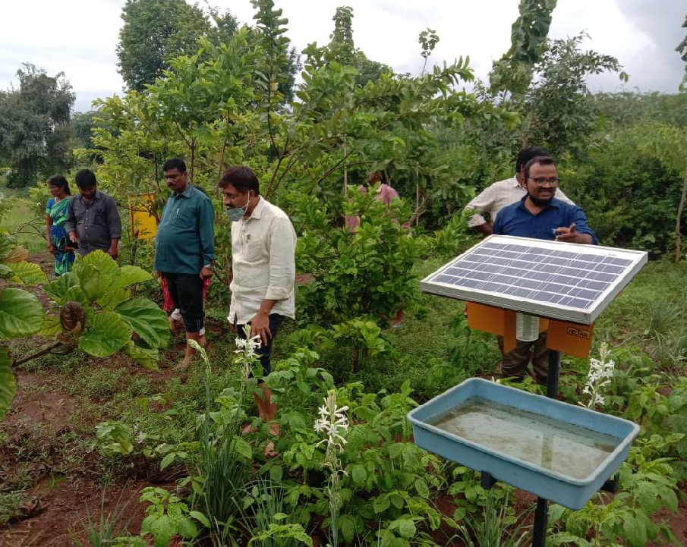
Agro ecology
Biodynamic Farming
Climate resilient agriculture
Climate smart agriculture
Community Managed Natural Farming
Non Pesticidal Management
Organic Farming
Permaculture
Regenerative Agriculture
Sustainable Agriculture
Zero Budget Natural Farming
Agroecological Approaches
An agriculture that aims to restore balance in ecological systems through a whole farm, family approach
Activism and movement Driven
Policy and Program Driven
Market Driven
OFAI
ZBNF/SPNF
Cow based Farming
Natural farming coalition
Sikkim
Andhra Pradesh
Kerala
PKVY program MOVCD
1000 Organic FPOs etc
24 Mantra
Suminter
Daman Organics
Sahaja Aharam

Slide 7
Permaculture
(Relies on farm design)
Farm designs | Natural products
Climate Smart Agriculture
(Relies on budling resilience)
Mitigation | Adaptation | Resilience
Community Managed Natural Farming
(Relies on community extension/management)
CRPs | FPOs | SHGs
Non Pesticidal Management
(Focus on ecological pest management)
Preventive Care | Microbials | Botanicals
Sustainable Agriculture
(Relies on farm and livelihood Sustainability)
Economic | Ecological
Biodynamic Farming
(Relies on natural processes and stellar movements)
Composts | Manures | Bio Sprays
Natural Farming
(Relies on farm made products)
ZBNF/SPNF | Fukuoka | Korean
Organic Farming
(Relies on farm made/commercial products)
Various Indian models | Biofertilisers/pesticides

Slide 8
Agroecological approaches Commonalities and variances
Commonalities
Increasing cropping intensity through Multiple cropping systems
Increasing soil organic matter
Increasing soil health particularly, microbial population
Differences
Degree of internalization of inputs
Microbial preparations used
Crop choices
narratives

Slide 9
Knowledge
Values
Organisations
Biological System
Technology
Coevolution of knowledge, values, organisations, technology and the biological systems

Slide 10
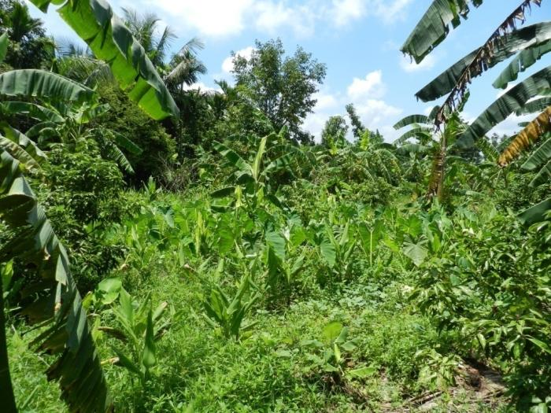
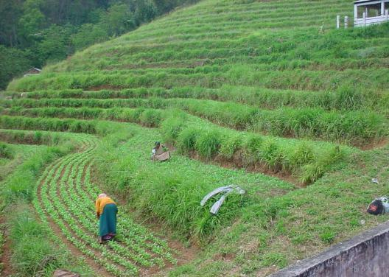
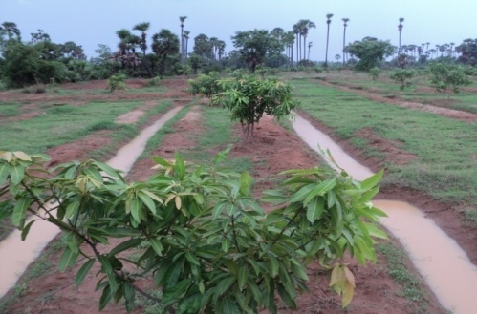
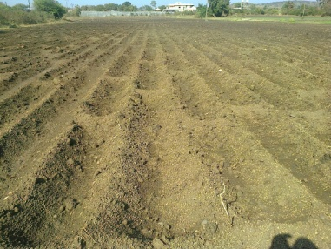
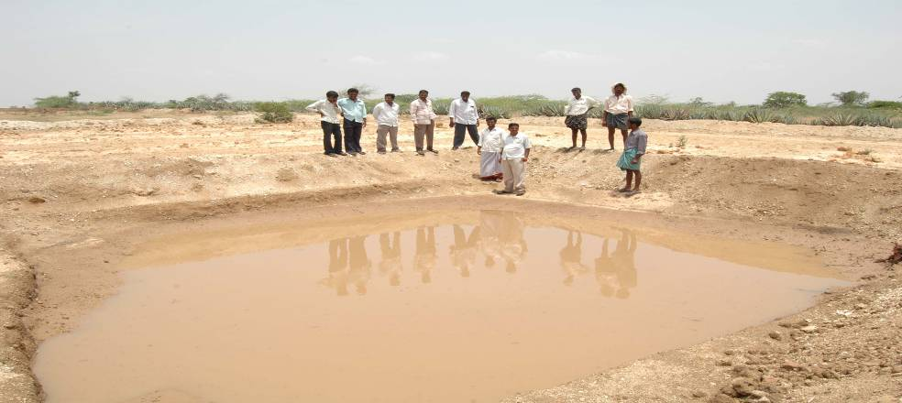
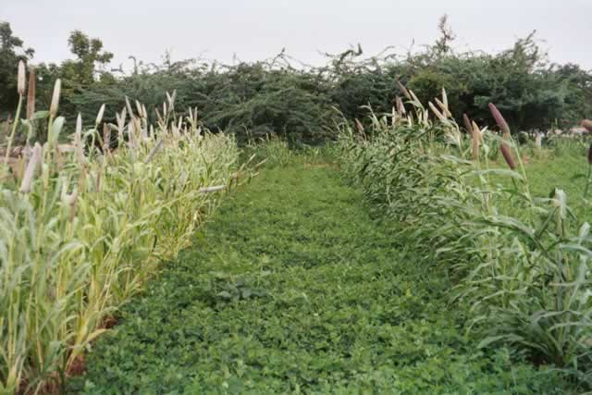
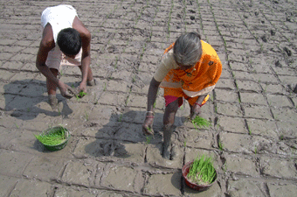
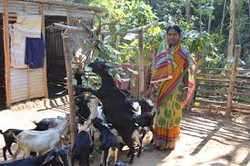
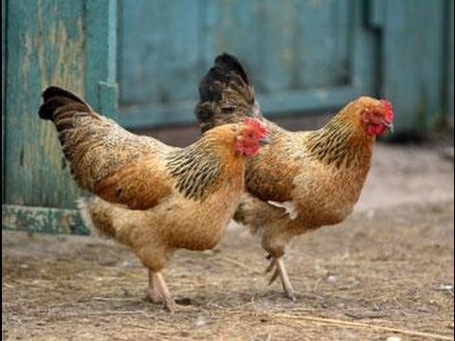
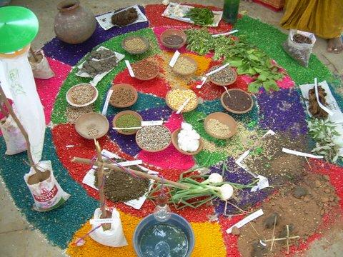
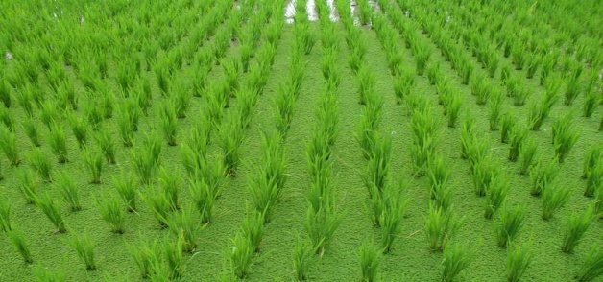
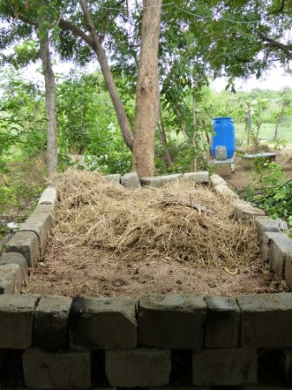
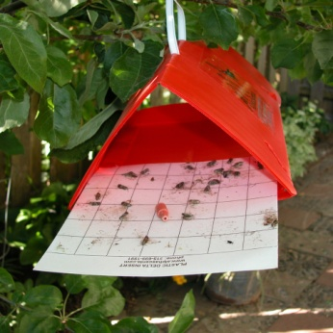
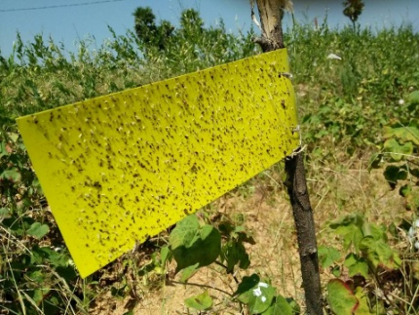
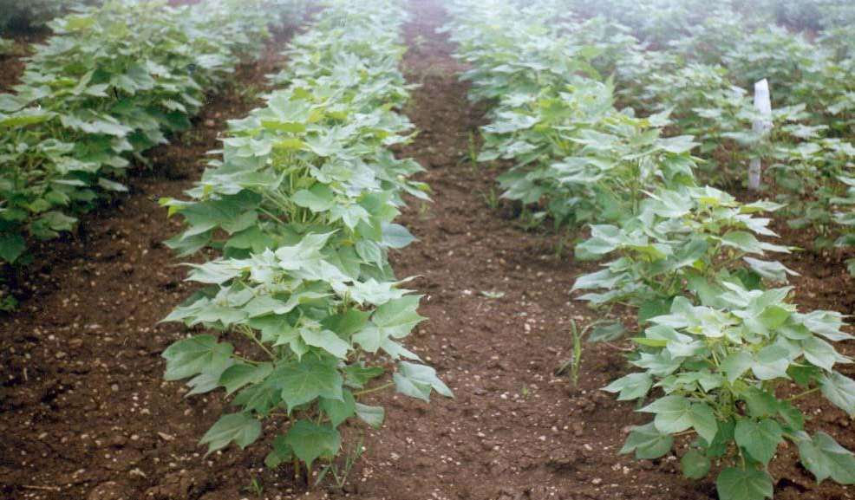
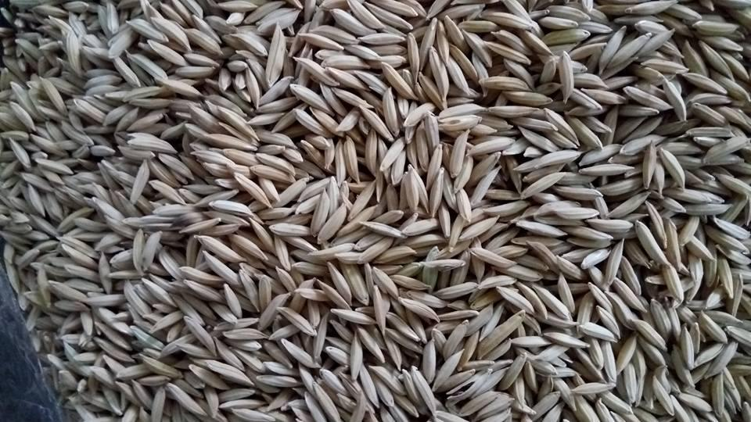
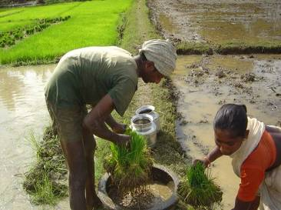
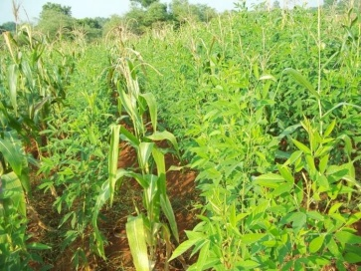
Core approaches
Adaptive Cropping Systems
Water and Moisture Management
Forward linkages
Integrating Livestock
Support Systems
Non Pesticidal Management
Sustainable Nutrient Management
Organic Seed System

Slide 11
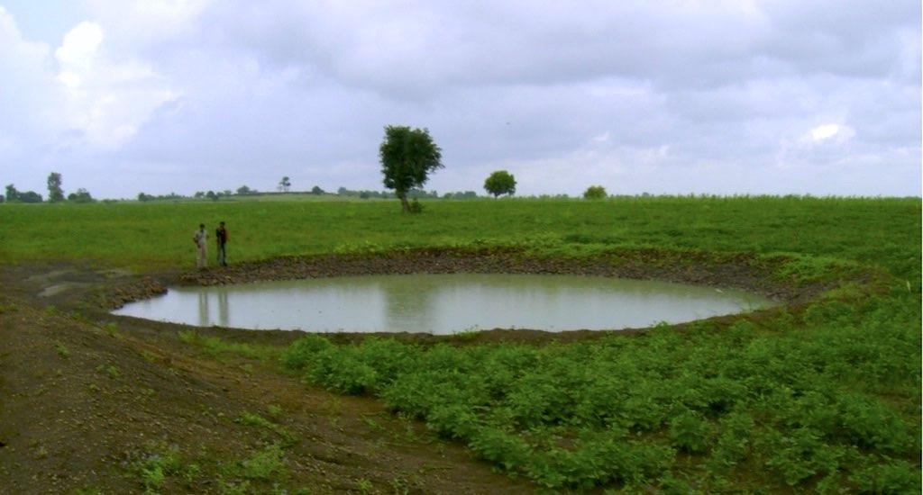
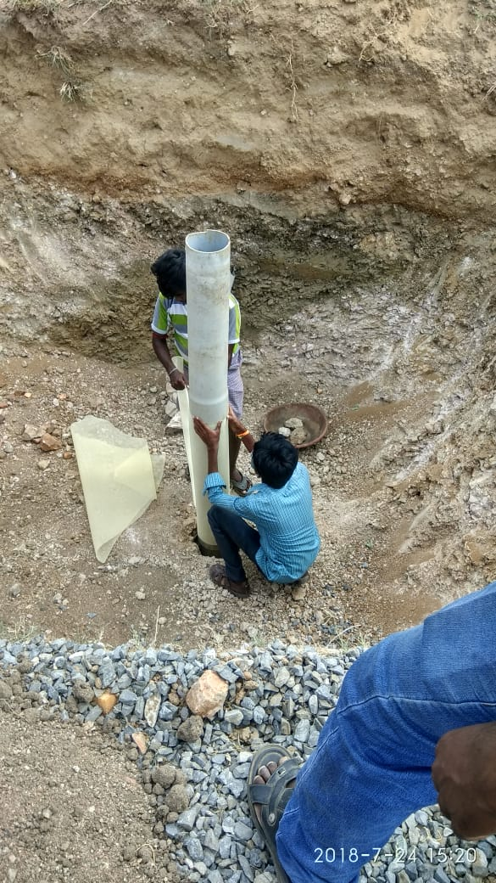
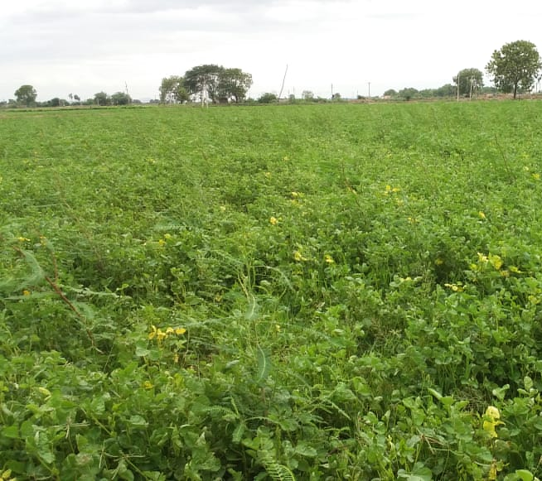
Water and Moisture Management
Water Budgeting: Cropping patterns based on local water resource and weather parameters
Rainwater harvesting: Grid lock, trenches, ponds
Harvesting atmospheric moisture: increasing soil cover, designing cropping patterns for 365 days
Increasing soil water and moisture holding capacity by increasing soil organic matter
Improved Water Use Efficiency: Micro irrigation systems, life saving irrigation plans, efficient cropping systems
Monitoring weather
Monitoring soil moisture
Advisories on abiotic stress management

Slide 12
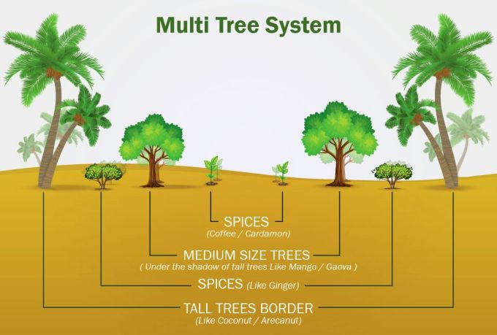
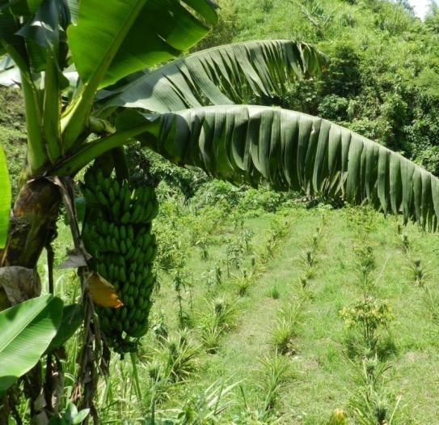
Adaptive cropping patterns
Cropping patterns based on soil type, water and weather parameters
Increasing cropping intensity (horizontal and vertical) through crop rotations and inter/multiple/poly crops
Designing farms, integrated farming systems
Managing living roots and green cover for 365 days
Staggered production systems for Fresh Fruits and Vegetables
Multi Tier Cropping System

Slide 13
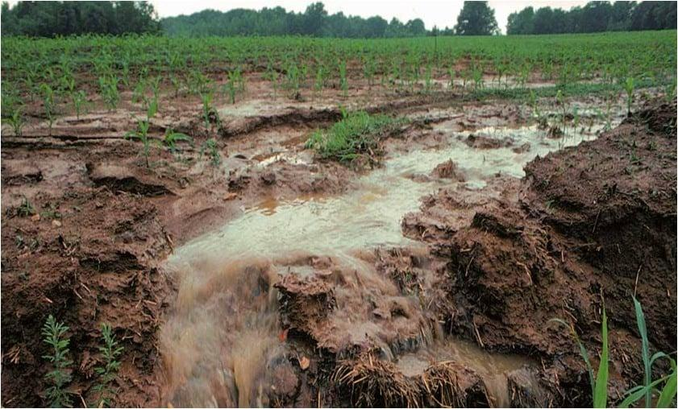
Sustainable Soil Management
Prevent Erosion
Prevent Compaction: Minimising tilling, shift to animal drawn tools,
Manage Soil Salinity: and pH: Organic amendments, cropping pattern changes, increasing soil organic matter
Increasing soil Organic carbon: Composting, Manuring, Mulching
Biological Nutrient Management: using home made, EMOs/IMOs, Biofertilizers
Bioenterprises: building local entrepreneurship for production on biofertilizers
Soil Quality Index
Problem diagnostic tools: soil quality, nutrition deficiencies etc (Probes, apps, manuals etc)
Physical Factors
Chemical Factors
Biological Factors
Soil Structure
Aggregate stability
Water holding capacity
EC
pH
Available Nutrients
Organic matter
Microbial diversity
Soil fauna
Soil Organic Carbon-Carbon Credits
Advisories on Crop Nutrient Management

Slide 14
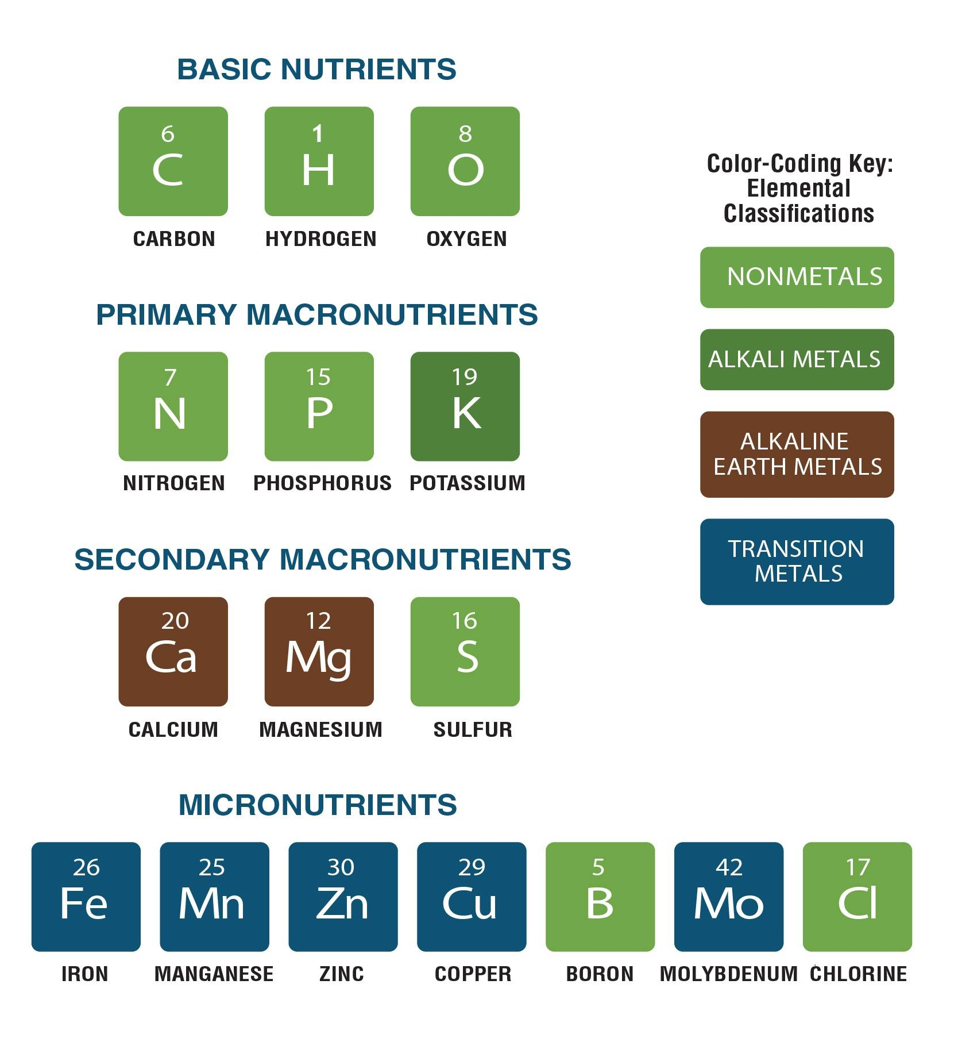
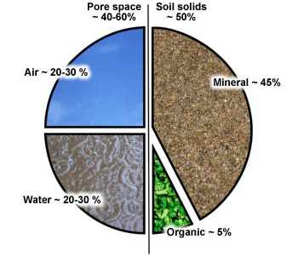
Nutrient recycling
Of the 50 to 70 elements that are found in living things, only 15 or so account for the major portion of living biomass
The cycling of nutrients in an ecosystem are interlinked by a number of processes that move elements (atoms) from and through organisms and to and from the atmosphere, soil and/or rocks, and water.
Nutrients can flow between these compartments along a variety of pathways. These pathways can be chemical processes or biological processes.
Soil structure, chemical and biological properties becomes critical
Air and Water
95%
Chemical fertilizers
Mineral matter
Organic matter
Microbes, Earthworms etc
Mineral matter
Organic matter
5%

Slide 15
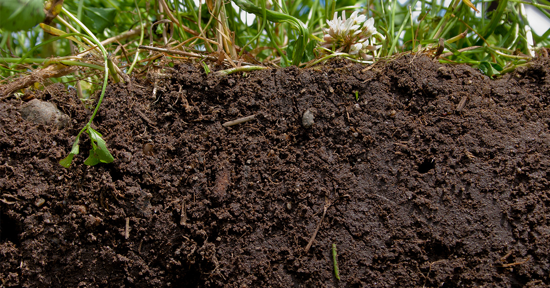
Soil health
Physical
Texture
Water holding capacity
Soil aggregate dynamics
Bulk density
Porosity
Compaction
Infiltration rate
Chemical
pH
Nutrient availability
EC-Salinity
Soil Organic Matter
Biological
C:N Ratio
Microbial activity
Micro flora and fauna
Enzymatic activity
Soil respiration
Cumulative physical, chemical and biological indicator of soil provides best soil to grow crop

Slide 16
Indigenous Microbial Solutions
Product Source of Micro Organisms
Cattle Dung: Cellulose, lignin solubulising bacteria, nitrogen fixing, phosphorus solubulising bacteria, endobacteria, entomopathogenic bacteria
Buttermilk: lacto bacillus
Toddy:
Soil: Pseudomonas, rhizobium, azatobactor etc
Source of nutrients
Sugars: Jaggery, sugar cane juice, honey, fruits etc
Fats: ghee, oil, oil cake
Proteins: pulse flours
The advantages of these Indigenous Microbial Products are
as they are collected from local soil and animal dung hence well suited for the local conditions
naturally occurring hence, are robust and survive adverse weather conditions.
they also reflect local microbial diversity
Based on this we suggest people to use
An application of the organic matter in any form is important. It can be used as mulching, composting, crops residues or green manures.
Dung from any animal (cow, ox, buffalo, desi or crossbred). Prefer animals which are foraging and feed on the green/dry organic matter than on grain or concentrates.
Management of desi animals is easy as they are small in size, low in input requirement

Slide 17
 | Conventional Approach (Recommended Dose of Fertilisers) | Hydroponics | Organic Soil Management
 |  |  | Organic manures | Biofertilizers | Natural Farming (Liquid manures)
Organic Matter | 4-5 tons of FYM | All nutrients are added in liquid and available form. The water pH is always correcte to stay neutral | Nutrient Equivalents When using these materials as a fertilizer base, calculate how much N, P2O5 and K2O are supplied by these materials, | 4-6 tons of biomass as mulch or compost | 4-6 tons of biomass as mulch/acchadhan
Nitrogen | 60 Kg N as urea/DAP |  |  | Nitrogen Fixers | apply apply 10-12 sprays of Jeevamrit/Panchagavya/Amri tjal/Waste Decomposer or equivalent farm made Microbial inoculants approximately 200-400 lit each application per acre.
Phosphorus | 40 Kg P as P2O5 |  | then supplement nutrients from other sources as needed for a particular crop | Phosphorus Solubilises
Potash | 40 kg K as K2O |  |  | Potash Mobilisers
 | Nutrient supply calculated based on the plant requirement minus available nutrients in soil |  | Biomass added (Green manure/Green leaf manure/cover crops/mulching) Animal Manures (Cattle dung, FYM, poultry litter), Decomposed organic matter (Vermicompost, NADEP compost, Biodynamic compost etc) Organic Concentrates (Bone meal, oil cakes etc) | 750 g-1.0 kg Other microbials as and where required

Slide 18
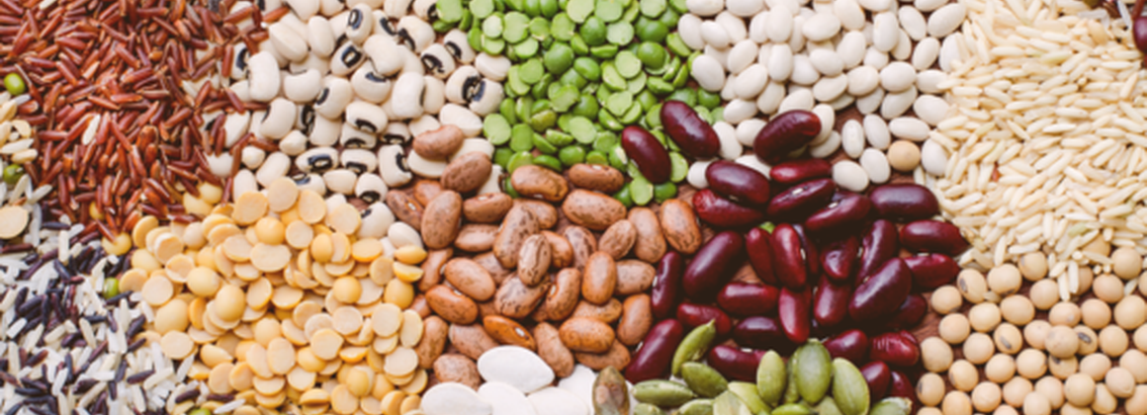
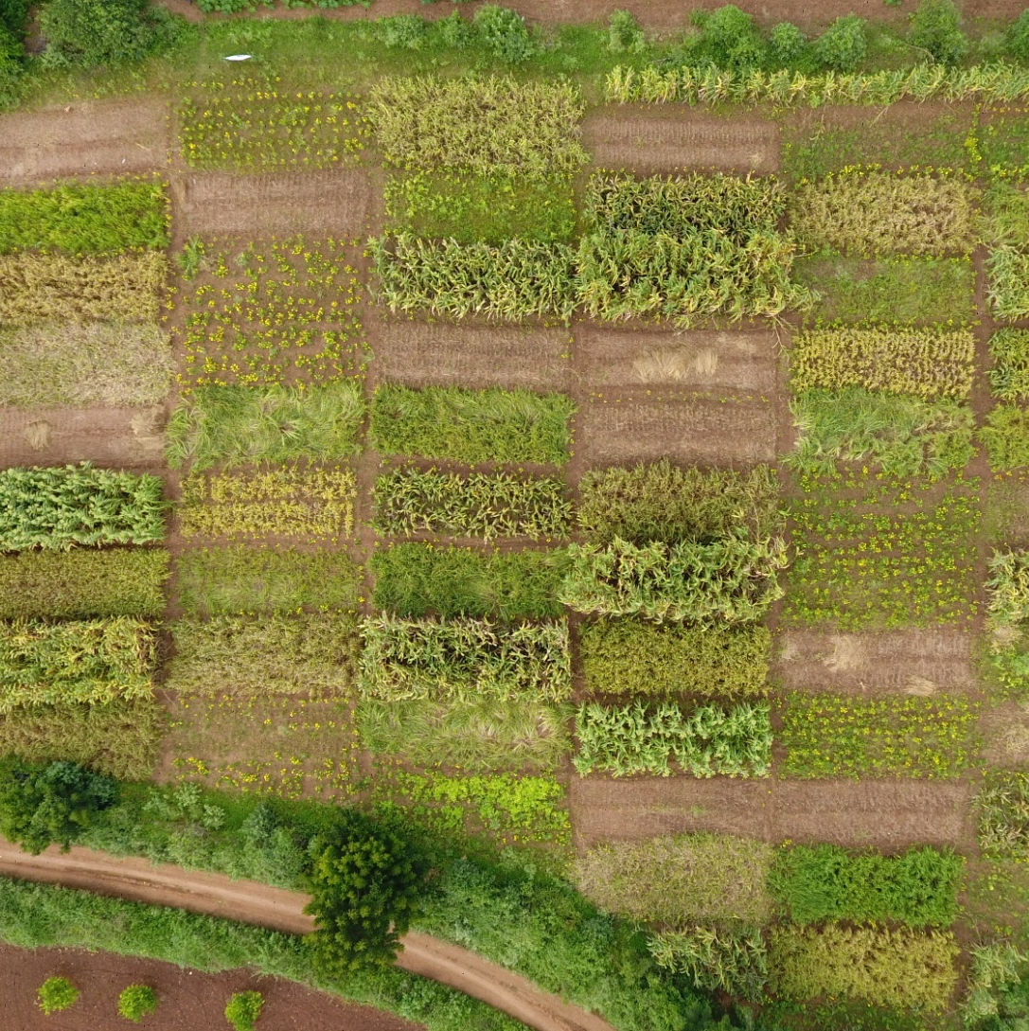
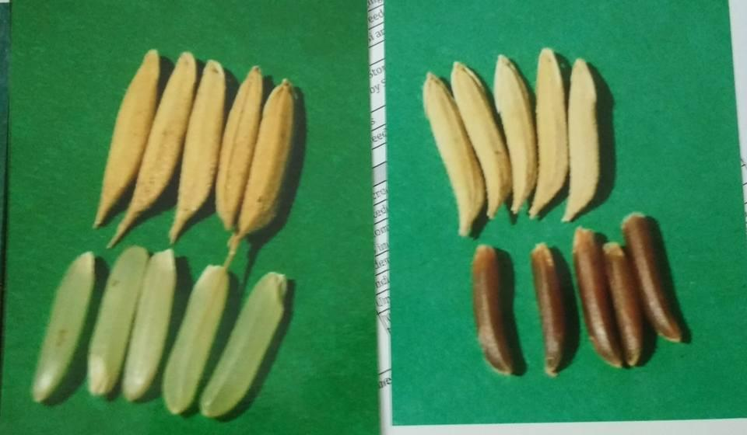
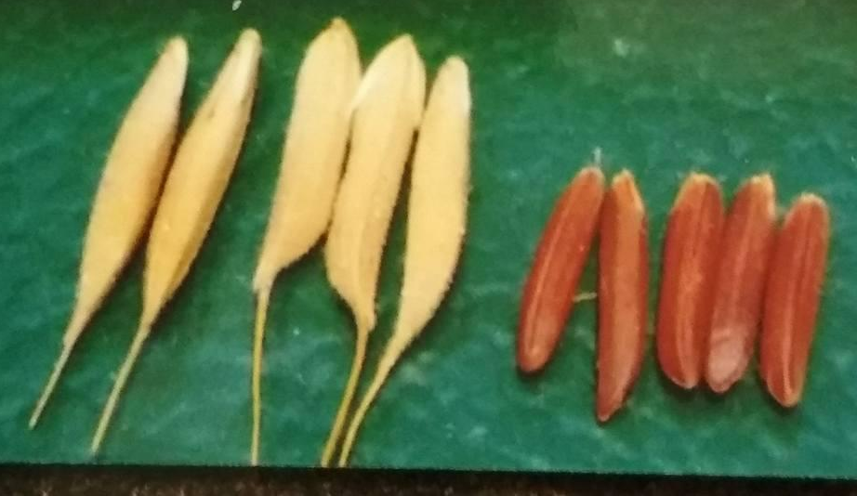
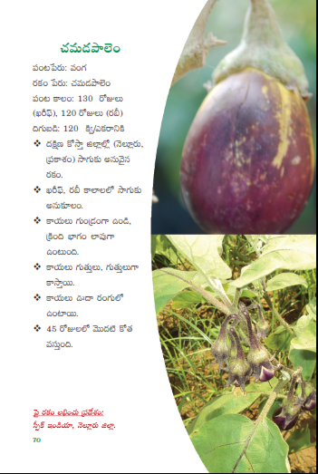
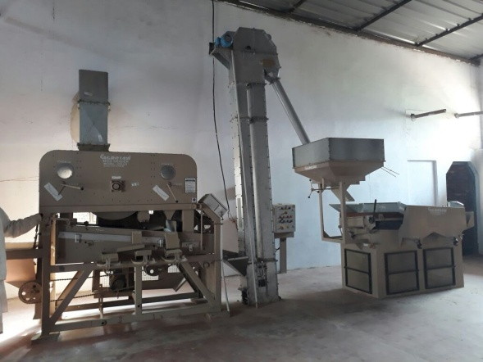
Organic Seed Systems
Identifying , conserving, documenting local diversity: Diversity mapping, revival of local varieties, characterisation
Participatory Varietal Selection to establish Value for Cultivation and Use: Diversity blocks, generating data on local performance, user preferences, Seed catalogue
No GMOs: No GMO use due to biosafety issues
Organic Seed Hub: Managing parental lines, Maintenance breeding, training and capacity building on seed production, coordinating between conservators, breeders, seed producers and marketing
Institutionalizing production and distribution: Community Seed Banks, Community Seed Enterprises, Farmer Service Centres for local production and distribution
Open Source Seed Licensing: arrangements that facilitate and preserve freedom of access and use of plant genetic material, prohibit exclusive rights, and apply to any subsequent derivatives of those materials
Creating Value for Diversity: developing processing, value addition and products to increase use

Slide 19
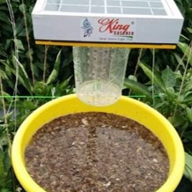
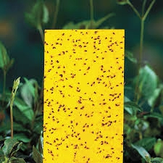
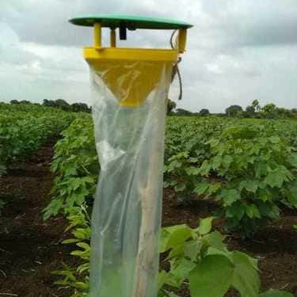
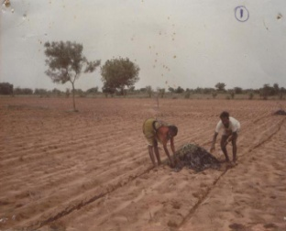
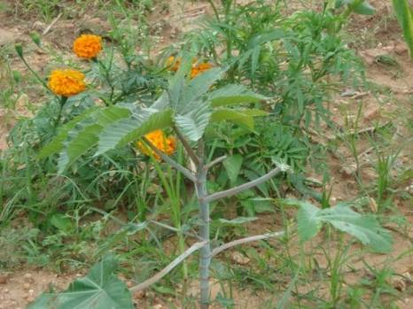
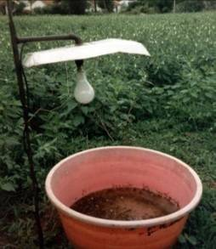
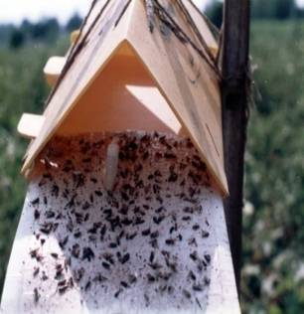
Non Pesticidal Management
Integrating management practices to prevent insects, diseases and weeds from reaching damaging stage / proportion
a natural ecological balance will ensure that pests do not reach a critical number in the field that endangers the yield
Light trap
Sticky trap
nature can restore such a balance if it is not meddled with too much, hence no chemical pesticides at all.
Pheromone trap
understanding the insect biology and crop ecology is important to take up right management practices-botanicals/microbials, farm-made/commercial
Pest Surveillance: Farm level and village level surveillance to identify pests and diseases using various traps to give alerts and advisories
Problem Diagnosis: Simple tools for problem identification (flip charts, apps, manuals etc)
Bioenterprises: building local entrepreneurship for production on biofertilizers
Weekly Advisories: based on local surveillance

Slide 20
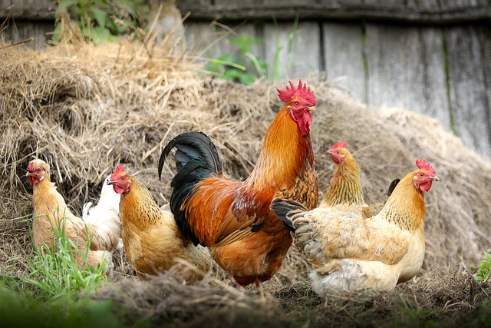
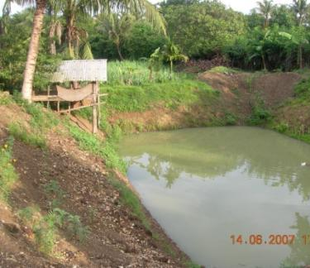
Integrating livestock
Integrated farming system for effective use of resources and ecological sustainability, creative use of space
Crop residues as fodder, fodder crops as part of cropping systems
cattle used for land preparation and intercultural operations
Back yard poultries, special breeds etc
Sheep and goat in rainfed areas
Fisheries in paddy fields, farm ponds, aquaponics etc
Animal waste as good manure
Cattle dung can be used to prepare microbial cultures, compost etc
Additional sources of income

Slide 21
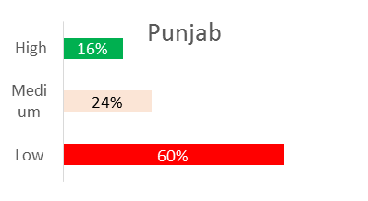
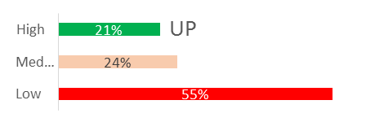
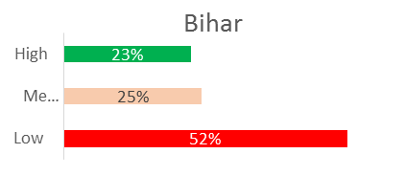
Low on Organic Carbon Content

Slide 22
Quantifying Soil Organic Carbon build up for Carbon Credits
New methodology using satellite imagery and ground truthing using PGS data
0.1% compared to previous years (<±0.02% at system level translates to 2.9 tons of CO2 stored per acre
3.0 tons per acre work out to 3.0*$ 10=$ 30 (Rs. 2,100). 50% to farmers and 50% can be used for operational management and support
Carbon

Slide 23
Carbon Equivalent Emissions from crop Fields Conventional Vs Organic/Natural
 | paddy |  | Wheat |  | Groundnut |  | Tomato |  | Papaya
Factors | Kg CO2 eq/ha | Kg CO2 eq/ha | Kg CO2 eq/ha | Kg CO2 eq/ha | Kg CO2 eq/ha | Kg CO2 eq/ha | Kg CO2 eq/ha | Kg CO2 eq/ha | Kg CO2 eq/ha | Kg CO2 eq/ha
fertiliser production | 2,664.47 | 657.79 | 177.13 | 597.99 | 1,709.00 | - | 1,345.73 | 920.91 | 5,826.94 | 4,609.22
direct and indirect field N2O | 1,103.22 | 116.43 | 817.87 | 576.88 | 782.90 | 554.45 | 3,819.34 | 411.02 | 13,051.38 | 734.55
paddy methane | 20,223.13 | 12,580.91
Pesticides | 82.00 | 20.50 | 20.50 | - | 41.00 | 5.13 | 151.70 | 20.50 | 82.00 | 124.64
crop residue management | - | 226.69 | - | 162.93 | - | 200.69 | - | 285.27 | - | 1,763.67
carbon stock changes | - | (248.99) | - | (629.41) | - | (219.27) | - | (199.57) | - | (1,218.33)
field energy use | 6,240.27 | 4,159.70 | 2,546.00 | 1,909.50 | 1,909.50 | 1,909.50 | 4,254.80 | 4,133.94 | 8,265.41 | 7,871.60
primary processing | 94.87 | 94.87 | 47.44 | 47.44 | 47.44 | 47.44
off-farm transport | 353.65 | 353.65 | 424.38 | 424.38 | 353.65 | 353.65 | 70.73 | 70.73 | 353.65 | 353.65
Totals | 30,761.61 | 17,961.56 | 4,033.32 | 3,089.72 | 4,843.49 | 2,851.59 | 9,642.31 | 5,642.81 | 27,579.39 | 14,238.99
% reduction | 42% |  | 23% |  | 41% |  | 41% |  | 48%

Slide 24
Local vs domestic vs global markets
Mainly fresh produce and processed foods for urban centres; possibly with some organic premium
Mainly staple food with little or no organic premium
Mainly commodities, with formal certification, organic and/or Fairtrade premium
Local rural markets
Domestic Urban Markets
Global Markets
Logistics, quality requirements, premium, competition

Slide 25
Organic Export and Domestic Market in India 2015-2020 (in INR Crores)
Export market: Rs. 11050 Cr
Growth rate of exports: 23.35% (CAGR)
Organised Domestic Market: Rs. 2000 Cr
Farmers Markets: Rs. 1800 Cr
Growth of domestic markets: 20-28% (CAGR)

Slide 26
India’s Organic Agribusiness potential by 2025
Demand side: Current Market size in 2021
Exports value: Rs. 11,050 Cr
Domestic markets (Organised): Rs 2,000 cr
Domestic markets (unorganised): Rs. 1800 Cr
Total: Rs. 14,850 Cr
World Organic trade at $ 110 bn (approx. Rs. 8.25 lakh Cr) which is 1.35% share
Supply side: Currently the value of produce from certified farms
Estimated value of approx. Rs. 25,000-35,000 Cr
With a growth rate of 25-30% per annum
Promising Future
World trade to cross $ 150 bn in 4-5 years
Even if India targets 2% of global trade we will have $ 3 bn (Rs. 25,000 Cr) market

Slide 27
Parameters measured
pH
Conductivity (EC)
Organic Carbon (OC)
Nitrogen (N)
Phosphorous (P)
Potassium (K)
Zinc (Zn)
Sulphur (S)
Boron (B)
Iron (Fe)
Manganese (Mn)
Copper (Cu)
Lime requirement for Acidic Soils
Gypsum requirement for Alkaline Soils
Rapid Soil Testing
Organic Transition Plans

Slide 28
Mother cultures
Farm level
Bioinputs
BioEnterprise
Bioinputs

Slide 29
PGS Regional Council

Slide 30
Sahaja Aharam Producer Company
Sahaja Aharam Retail is a division of Sahaja Aharam Producer Company Ltd., (SAPCO) which is a federation of 21 Farmer Producer Organizations (FPOs) across the states of Andhra Pradesh and Telangana from 2014
Sahaja Aharam Retail is an initiative to connect farmers directly to Consumers (F2C) to get price realization
Each packet sold under 'Sahaja Aharam’ is grown by member farmers and processed in company owned facilities and can be traced back to farmer.
Mission
Sahaja Aharam is committed to providing the highest quality, fresh and natural food to the consumers directly from the farmers there by improve the health of the consumers, better price realization for farmers

Slide 31
Grameen Academy
Learning for transformation
31
www.grameenacademy.in

Slide 32
Centre of Excellence for Agroecology, Vijayawada
facilitate adaptive research and developing knowledge, information, technologies, data that support/enhance sustainable innovations in farming, rural businesses and public policy
engaging in consumers oriented research and extension
develop as a centre for rural entrepreneurship development and support individual and group enterprises, and farmer producer organisations
build the capacities (knowledge and skills) of farmers, front line workers, students, academicians and policy researchers
Work in collaboration with local, national and international organizations and contribute to the betterment of farmers and farming based livelihoods

Slide 33
Strategies for scaling up
Phased and targeted approach: Not all of regions, crops, population segments, etc., are equally suited and prepared. Hence, a targeted and phased approach will maximize feasibility and impact
GAP > NPM > Organic
Strengthen and generate robust, local evidence: for different Agro Climatic zones/districts across the state
Focus on innovation and customization: One standard package is not going to work. Standardise broad principles and let context specific PoPs evolve
Saturation approach: Continued engagement with villages until a significant adoption (70- 80%) is achieved
Enabling the support services: FPOs, Bioenterprises, PGS/Certification systems, Seed systems etc
Using Practicing farmers in extension: Community extension system works well

Slide 34
Thank you
csa@csa-india.org
pgs@csa-india.org
info@sahajaaharam.com
organicmandi@csa-india.org
grameen@csa-india.org
Call on 8500 68 3300
8500 78 3300
8500 98 3300
http://www.csa-india.org
http://www.sahajaaharam.com
http://www.grameenacademy.in
http://www.greendunia.com

